Slide 1

Welcome to the

Slide 2
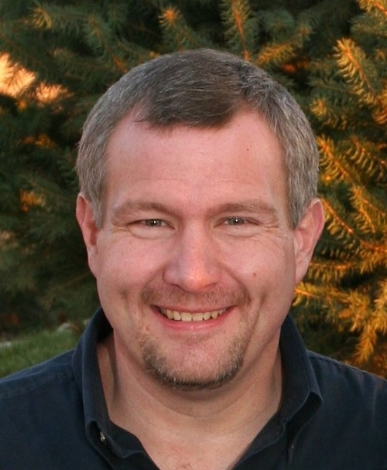
Mike Erickson
Independent Consultant
Software Developer, Architect, Trainer, Speaker, Author, Active Member of Local Technical Communities
GitHub: mgerickson
@mgerickson
Linkedin.com/in/mgerickson
mgerickson.blogspot.com

